Slide 1
Intern Project Final Review
Intern: Javvaji Jyoshna
Manager: Rejith K
Mentor: Debjit Roy

Slide 2
Table of Contents
I. | Overview of Perfect print
II. | The Problem Statement
III. | Purpose of the Project
IV. | Architecture of Perfect Print
V. | Flow of Advertisement Detection
VI | Resnet50 Architecture
VII. | One-Class Support Vector Machine
VIII. | Results
IX. | Project Progress
X. | Current Focus
XI. | Future Scope
XII. | Milestones Achieved

Slide 3
Overview of Perfect Print
Perfect Print is a project developed to improve the user experience while printing content by offering smart customization options.
It allows users to control unwanted print elements such as headers, footers, extra white spaces and advertisements through simple toggle switches.
The system integrates AI-based Advertisement Detection to automatically identify ad images before printing
Users can preview and remove these ad sections, ensuring a clean and content-focused print output.

Slide 4
The Problem Statement
To develop a detection system that automatically detects whether a given image is an advertisement or not
To integrate with a larger document analysis pipeline that:
Analyzes documents before printing
Extract Images from pdf
Detects and classifies images as Advertisement or Non-Advertisements
Allows toggling visibility of headers, footers, and detected advertisements

Slide 5
Purpose of the Project
Unwanted content like headers, footers, and advertisements often get printed
To reduce the Number of pages by white space optimization
Improves user experience by offering a clean and focused print layout
Supports environmental goals by reducing unnecessary ink and paper use

Slide 6
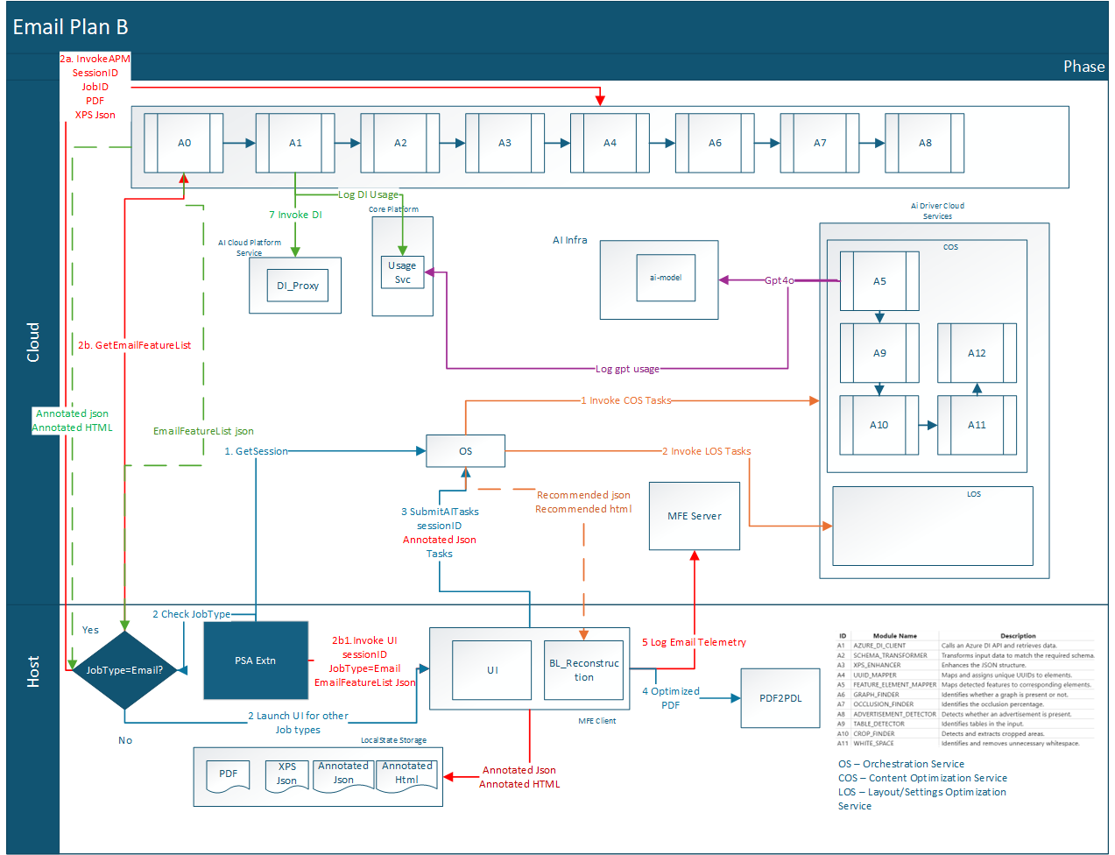
Architecture of perfect Print

Slide 7
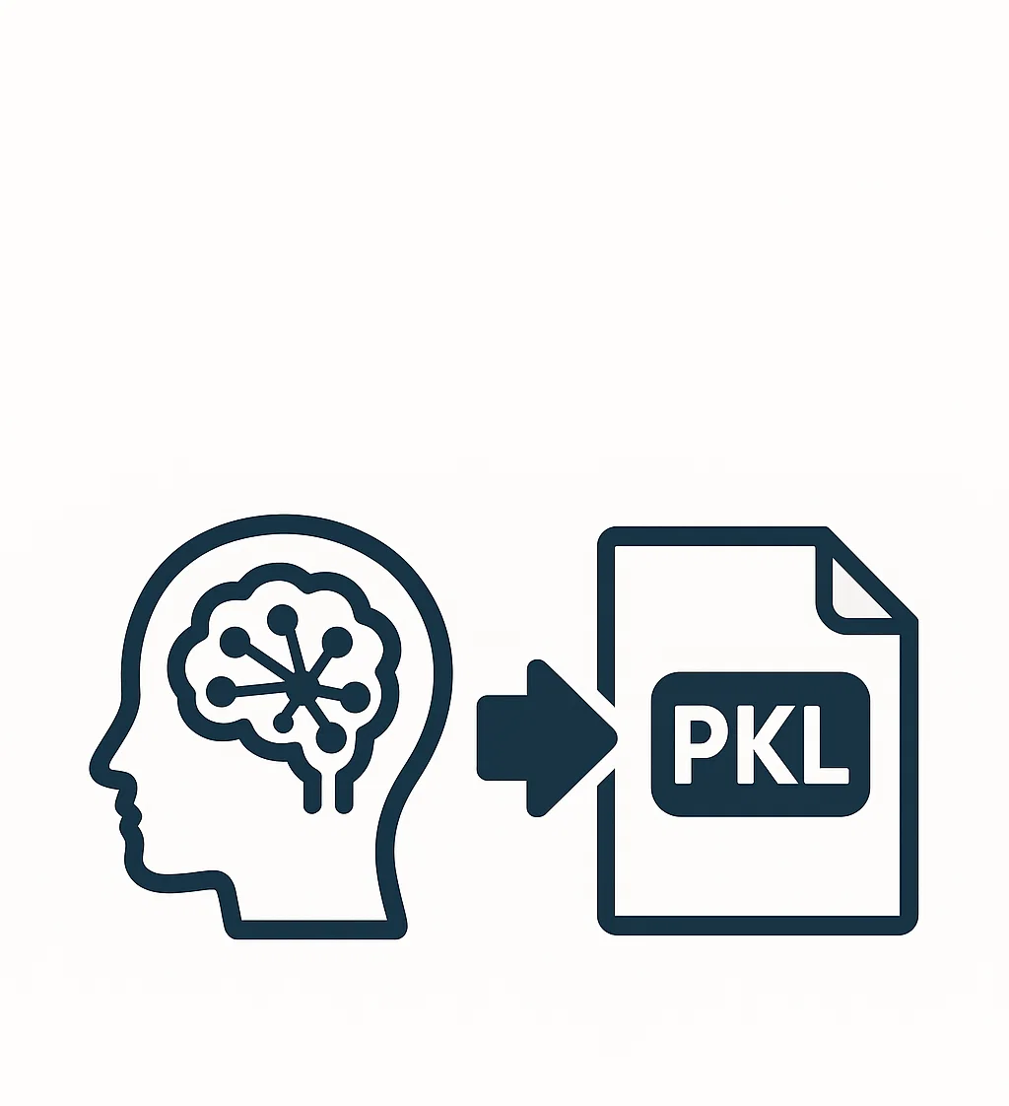









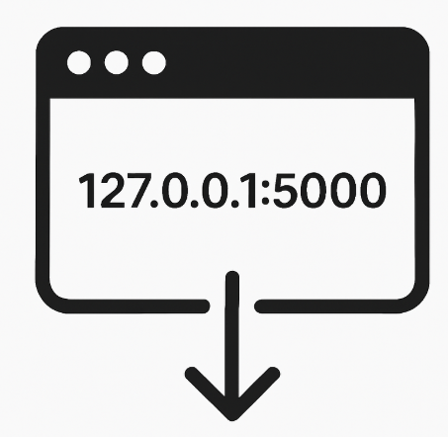

Flow of Advertisement Detection
Model Training
Load Dataset
Preprocessing
Feature Extraction & scale(ResNet50)
Train/Test Split
Training one-class SVM
Save the model
Inference
Flask api endpoint
Upload image (Input)
Preprocess and extract features
Scale features
Model prediction
(One-class SVM )
Predict Advertisement or Non-Advertisement

Slide 8
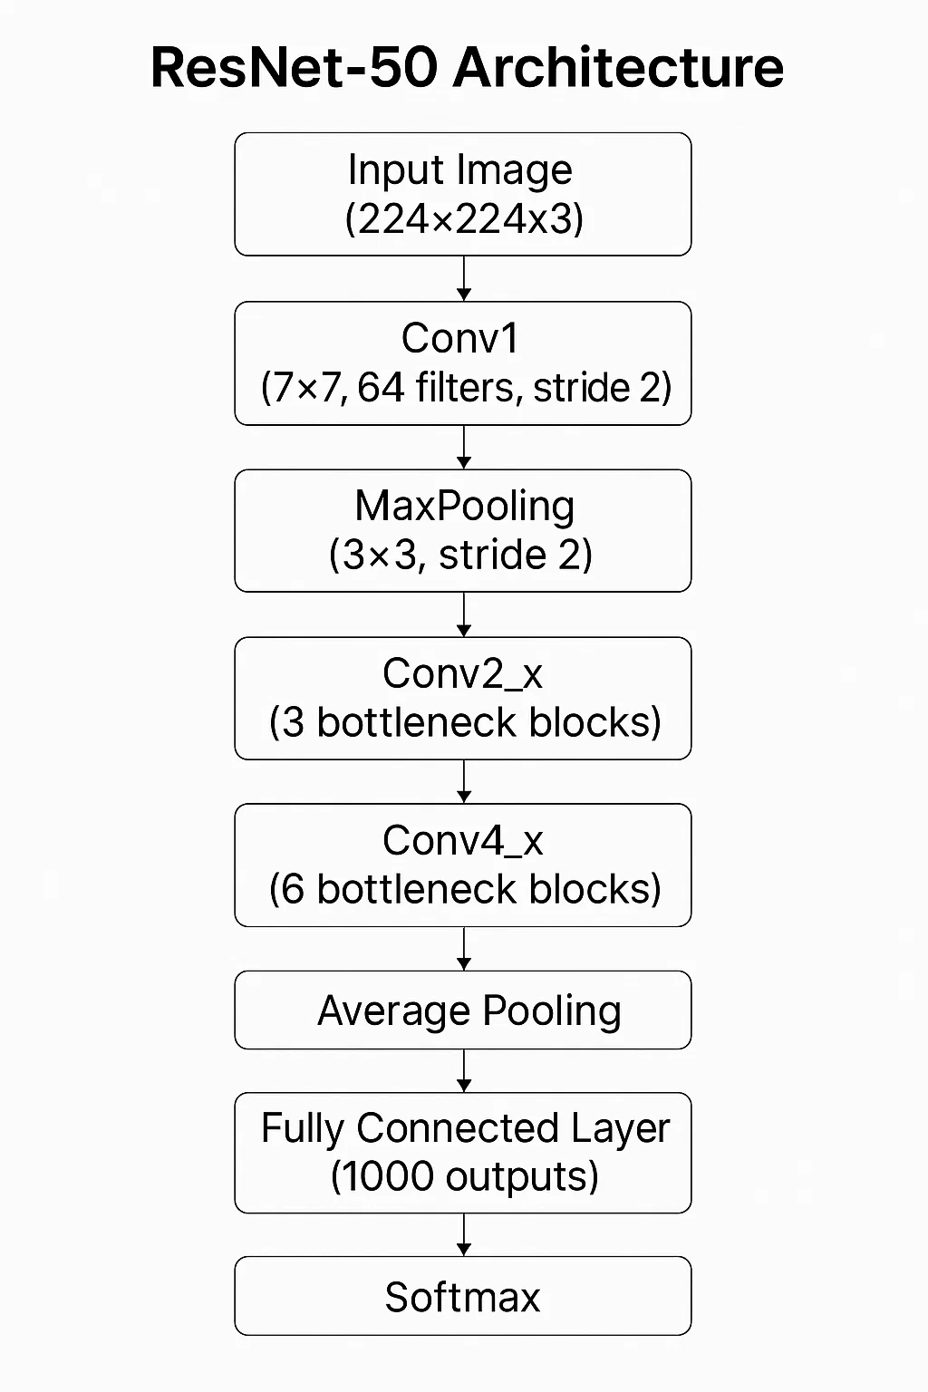
Resnet50 Architecture
ResNet-50, developed by Microsoft Research Asia in 2015 , is used as a feature extractor to capture complex image patterns. It is pre-trained on the ImageNet dataset.
50 layers deep
Used for image classification, feature extraction, etc.
Pretrained on ImageNet

Slide 9
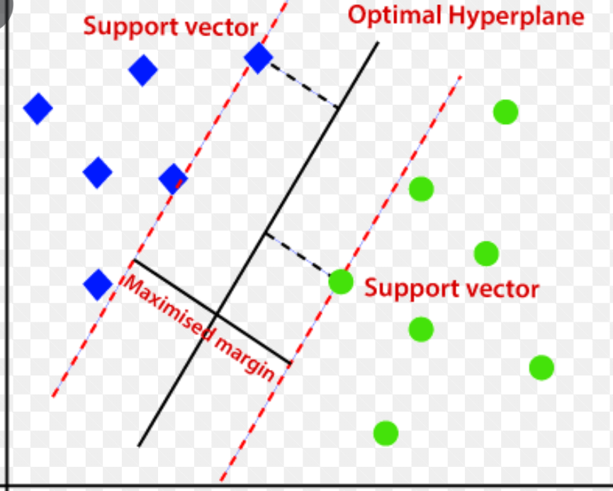




One-Class Support Vector Machine
One-Class SVM is a semi-supervised algorithm that learns the pattern of normal data and detects anomalies by classifying anything outside this pattern as outliers.
Input features
Kernal Function
Decision Boundary Learning
Decision Function

Slide 10
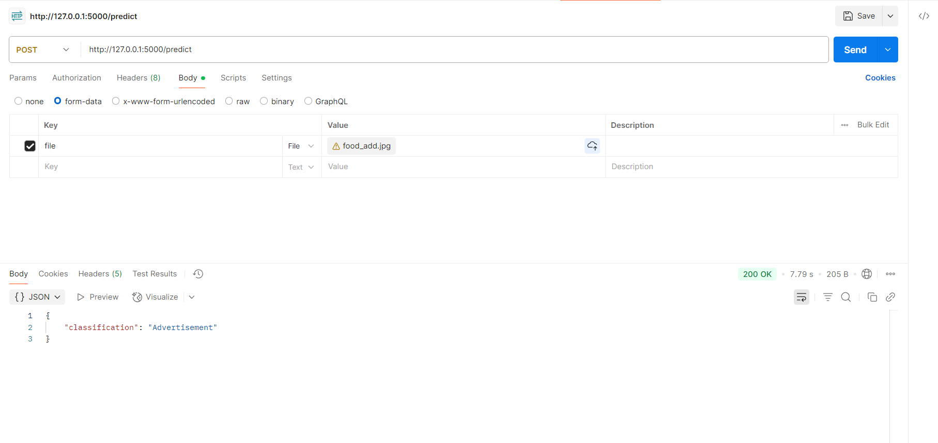
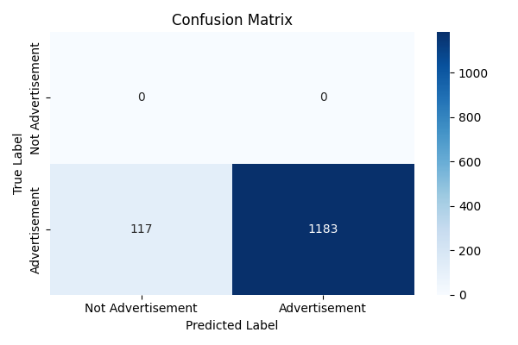
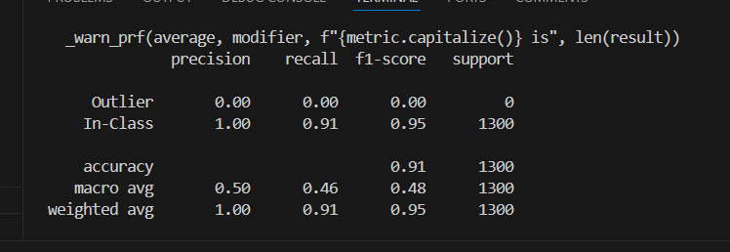
Results
The trained model achieves a high in-class precision of 100% and a recall of 91%, with an overall classification accuracy of 91%.

Slide 11
Project Progress
Project Understanding & Problem Definition
Feature Extraction using ResNet50
Can be detected as advertisement or not
Data Collection & Preprocessing
Model Training using One-Class SVM

Slide 12
Current Focus
Using Azure Document Intelligence to extract full document layout in JSON.
Enables users to toggle and remove elements like headers, , and advertisements for cleaner prints.
Facing challenges with cost, cloud dependency, and slow performance.
Working on faster, cost-effective approach to replace Azure DI.

Slide 13
Future Scope
🖨️ Smart Print Customization: Users can easily toggle ad visibility before printing, giving full control over what gets printed.
🌱 Eco-Friendly Printing: Contribute to sustainability by eliminating unnecessary ink and paper usage.
🖨️ Reduces number of pages: Automatically removing advertisements reduces overall page count, saving paper .

Slide 14




Milestones Achieved
Gained understanding of ML concepts, including supervised and unsupervised learning techniques.
Explored feature extraction methods for image classification, leveraging deep learning models like ResNet50.
Analyzed model performance with evaluation metrics like precision, recall
Developed and trained One-Class SVM for anomaly detection, applied to advertisement classification.

Slide 15
Thank You

